Slide 1
Learning Curve

Slide 2
Performance improvement
As an organization gains experience in manufacturing a product, the labor inputs required per unit of output diminish over the life of the product
If you repeat a new task continually your performance improves. Performance time drops off dramatically at first, and it continues to fall at some slower rate until a performance "plateau, a leveling off" is reached
Learning phenomenon occurs for groups and organizations as well as for individuals

Slide 3
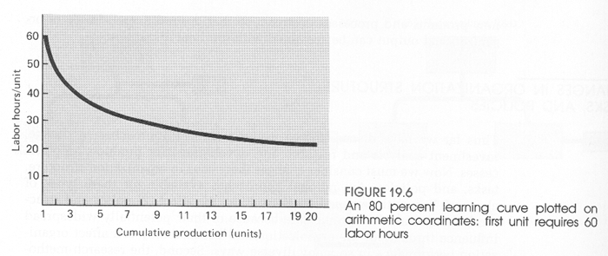
Learning curve
General form of the pattern is called the learning curve

Slide 4
General equation for the learning curve
Y_{X} = kX^{L}
Y_{X} = labor hours required to produce Xth cumulative unit of output
k = labor hours required to produce first unit of output (initial productivity)
L = index of learning
X = production unit number

Slide 5
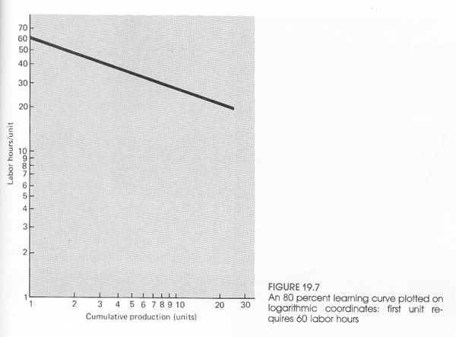
Exponential curve becomes a straight line in log-log coordinates

Slide 6
Equations of the exponential curve
log Y_{X} = log kX^{L}
log Y_{X} = log k + log X^{L}
Rearranging,
log Y_{X} = L log X + log k
Equation of a straight line: y = mx + b
y = log Y_{X}
x = log X
m = slope = L = (y2 - y1)/(x2 - x1) = (log Y_{X2} - log Y_{X1})/(log X2 - log X1)
b = y-intercept, when x = 0 (log X = 0, X = 1) log Y₁ = log k, k = Y₁

Slide 7
Learning rate (or rate of learning)
Learning rate is specified as a percentage
i.e. 80% curve - each time cumulative output doubles the newest unit of output requires 80% of the labor of the reference unit
Also interested in average labor per unit for certain quantity production run (from above, average labor per unit assuming 4 units is 78.55 hours)
Unit | Hours
1 | 100
2 | 80
(3) | (70.21)
4 | 64

Slide 8
Determining index of learning from the learning rate
Previously, L = (y2 - y1)/(x2 - x1) = (log Y_{X2} - log Y_{X1})/(log X2 - log X1)
L = (log (Y_{X2}/Y_{X1}))/(log (X2/X1))
For first unit, X1 = 1 and Y_{X1} = k
L = (log (Y_{X2}/k))/(log (X2))
i.e. for learning rate of 80%, L = (log (80/100))/(log (2)) = -0.3219

Slide 9
Learning rate to use
Learning rate is not the same in all manufacturing applications - learning is more significant in some applications than others and is reflected by more rapid descent of the curve (and a lower learning rate)
The rate is influenced by
Worker experience level
Desired degree of conservatism applied
Amount of process controlled by machine should be taken out of the labor content when applying the effect of learning and then added back in with no adjustment for learning
Theoretically the approach assumes learning continues indefinitely - this is not realistic, it will level off at some point (the 10th, the 20th, or maybe the 50th unit?)

Slide 10
Example
Captain Nemo, owner of the Suboptimum Underwater Boat Company (SUB) is puzzled. He has a contract for 11 boats and has completed 4 of them. He has observed that his production manager, young Mr. Overdoit, has been assigning more and more people to torpedo assembly after the construction of the first four boats. The first boat, for example, required 225 workers, each working a 40-hour week, while 45 fewer workers were required for the second boat. Mr. Overdoit has told them that "this is just the beginning" and that he will complete the last boat in the current contract with only 100 workers!
Mr. Overdoit is banking on the learning curve, but has he gone overboard?

Slide 11
Example
SUB has produced the first unit of a new line of minisubs at a cost of $500,000 - $200,000 for materials and $300,000 for labor. It has agreed to accept a 10 percent profit, based on cost, and it is willing to contract on the basis of a 70 percent learning curve. What will be the contract price for three minisubs?

