Slide 1
Process Improvement (Lean Concepts)

Slide 2
Origins of Lean
Lean concepts evolved from the JIT philosophy pioneered in Japan by Toyota and embodied in their Toyota Production System
The emphasis of JIT is the elimination of waste throughout the supply chain
In the 1990's companies adopted the term lean in place of JIT

Slide 3
The Basis of Lean Thinking
Lean means producing
What is needed
When it is needed
With the minimum amount of materials, equipment, labor, and space
Producing what is required, when it is required, but with minimal investment
The goal of an enterprise adopting lean
Make each process as efficient and effective as possible
Connecting those processes in a stream or continuous chain that is focused on flow and maximizing customer value

Slide 4
Flow
Flow is defined as continuous movement of products and information through a value stream
The goal of a lean enterprise is to minimize idle time in the value stream (idle time equates to inefficiency and waste)
Winona Sandwich Company example
Daily special
Custom order
Example parameters
Notes:
1 click = 10 sec, yell left, right, both
10 people, two fists (sandwiches)
Cut bread – 10 sec (open fist)
Add meat – 10 sec (add stir stick)
Add toppings – 20 sec (add penny)
Add condiments – 20 sec (add paperclip)
Packaging – 10 sec (close fist)
Total processing time to make a sandwich: 70 sec
How long before first sandwich complete:
20 x 10 sec = 200 sec
20 x 10 = 200
20 x 20 = 400
20 x 20 = 400
1 x 10 = 10
Total = 1210 sec = 20.17 min
% of time in process with nothing done to it = (1,210 sec-70 sec)/1,210 sec = 94.2%

Slide 5
Winona Sandwich Company Daily Special
How long before first sandwich ready?
Majority of time is idle time - no work is being performed on a sandwich
Batch process
Push system
Completes a predetermined quantity of work from an established work queue or forecast
Typically, the work queue or forecast is offset to the actual customer demand to allow time for production and delivery
High inventory
High degree of risk
Yet a great convenience for customers in a hurry
No flow

Slide 6
Single-piece Flow Process
Winona Sandwich Company Custom order
Single-piece flow process
Process of creating a sandwich is triggered only when a customer order initiates the process
Pull System
Completes a quantity of work that is directly linked to customer demand
Materials are staged at the point of consumption
As materials are consumed, signals (kanban) are sent to previous steps in the process to pull forward sufficient materials to replenish only those that have been consumed
Total flow
Ultimately selection of the model to be implemented should be dictated by marketplace demands with the goal of maximizing customer value

Slide 7
Customer Value
Customer value refers to specific activities that add value to the products and services customers buy
Determination of what is value-added is made from the customer’s perspective
Under lean philosophy for an activity to be value-added it must meet the following three criteria:
(1) The customer must be willing to pay for the activity
(2) The part or the object must change (movement?, inspection?)
(3) It must be done right the first time
Non-value-added activity → waste
Viewing a process in the context of what is truly value-added, a different perspective will emerge for the opportunities for improvement

Slide 8
Waste
A key tenet under the philosophy of lean and continuous improvement is to minimize non-value-added tasks and eliminate the sources of waste
Seven sources of waste, DOTWIMP (ref: Fiore, Clifford)
Types of Waste | Factory Waste Example
Defects | - Part failing functional test - Part feature violating drawing dimensions
Over-production | - Machining parts with no usage requirement
Transportation | - Moving parts from one machine to another
Waiting | - Partially machined parts on the shop floor queued for the next operation
Inventory | - Completed parts that have not been purchased
Motion | - Extra process steps
Processing | - Part inspection

Slide 9
Required Waste vs Pure Waste
Waste can be further classified as required waste and pure waste
Required waste represents activities that do not meet the three criteria for a value-added task but are still necessary to support the creation of a product
Activities may be mandated by the customer and/or government regulation (i.e. inspections/tests)
The most obvious examples of pure waste (greatest opportunity for improvement) are associated with the idle time within a process
Pure waste activities represent the top priority for elimination
Video

Slide 10
Single Minute Exchange of Die (SMED)
Tool/die changeovers disrupt production – production is stopped while tools/dies are changed
Idea behind SMED (originated at Toyota around 1970 by Shigeo Shingo) is that a significant portion of the die-changing operation can be done off-line while the previous die is still in place and the line continues to operate
Die-changing operation is divided into two components: inside exchange of die (IED) and outside exchange of die (OED)
OED portion is performed while the line is operating in advance of the actual exchange – the goal is to structure die change so that there are as many steps as possible in the OED portion
Tool/die changeovers typically reduced from hours to minutes

Slide 11
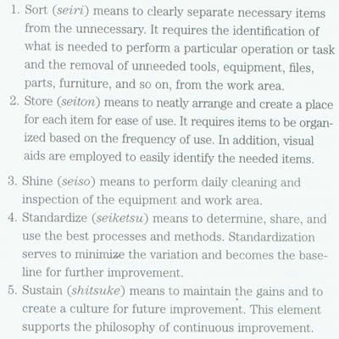
Five S (5S) Methodology
5S transforms and maintains a work environment that supports lean implementation

Slide 12
Additional Benefits of 5S Methodology
5S provides the foundation for creating discipline in the workplace
It helps cultivate relationships in the company and raises employee morale
Work areas that are neat and clean will gain credibility with customers, suppliers, and visitors to the company

Slide 13
Value Stream
The value stream represents the linkage of all value-added and non-value-added activities associated with the creation of a product or service desired by a customer
In manufacturing: raw materials → finished product
In product development: design concerns → technical data package (drawings)
The goal in reviewing/studying the value stream is to maximize customer value

Slide 14
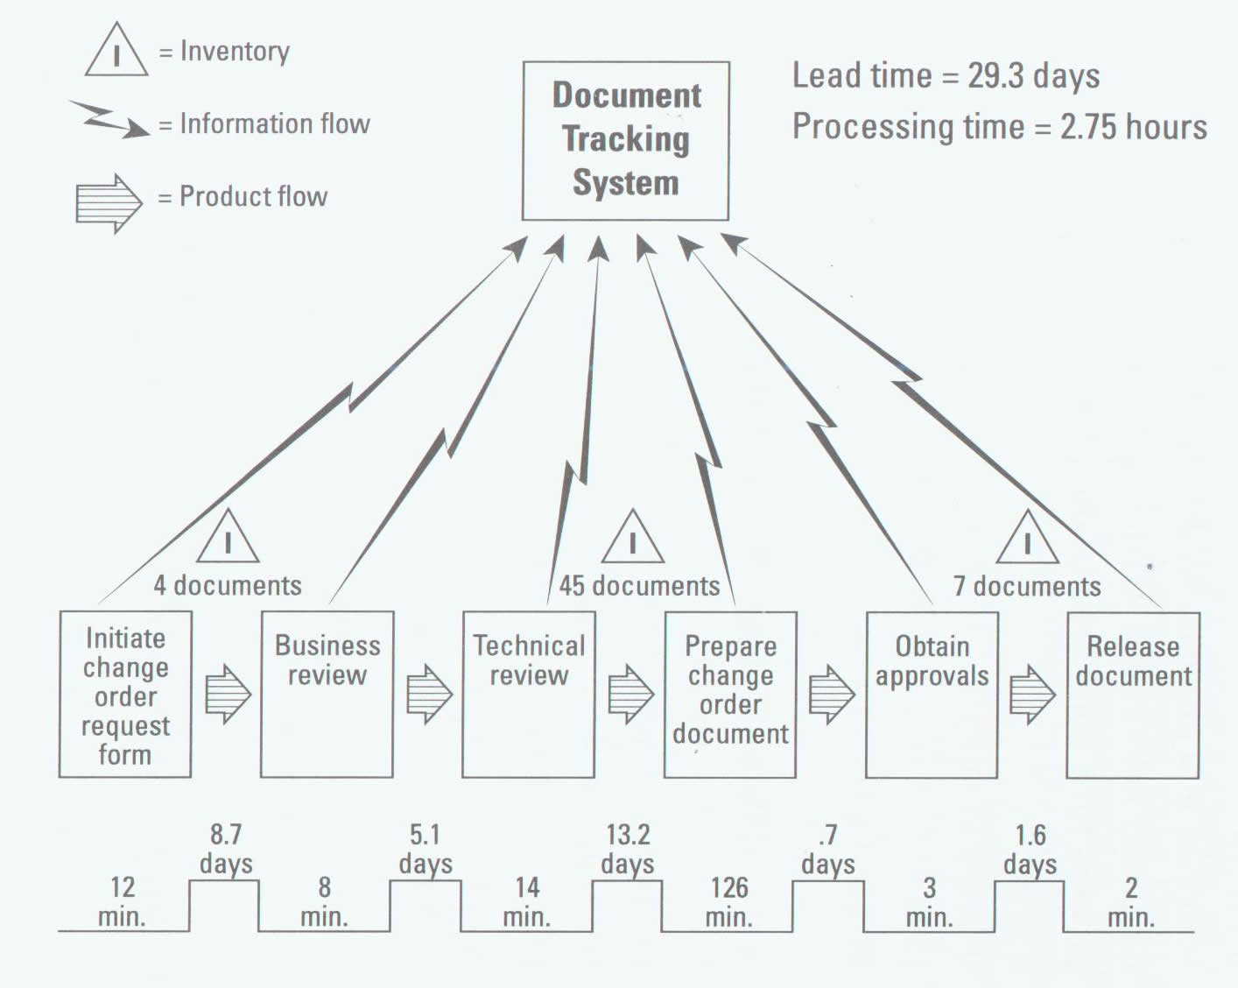
Value Stream Map

Slide 15
Benefits of Developing a Value Stream Map
Allows more than just the visualization of the activities in the process
Helps identify the sources of waste and impediments to flow
Helps identify the information flows as well as the product and material flows in a process
Helps reduce “cherry picking” of improvement projects

Slide 16
Five Lean Principles
(1) Specify value in the eyes of the customer
(2) Identify the value stream and eliminate the waste
(3) Make value flow at the pull of the customer
(4) Involve and empower employees (there is no better source of insight than the employees who are performing the work)
(5) Continuously improve (kaizen) in pursuit of perfection

Slide 17
References (sources of graphics)
Fiore, Clifford, Accelerated Product Development: Combining Lean and Six Sigma for Peak Performance, Productivity Press, NY, NY, 2005.
Hamilton, Bruce, “Toast Kaizen, An Introduction to Continuous Improvement & Lean Principles,” Greater Boston Manufacturing Partnership, University of Massachusetts, Boston, MA, 2005 (DVD).
Insights On Implementation-Improved Flow: Collected Practices and Cases, Ralph Bernstein, Editor, Productivity Press, 2006.
Jacobs, Robert F. and Chase, Richard B., Operations and Supply Management: The Core, McGraw-Hill/Irwin, NY, NY, 2008.
Nahmias, Steven, Production & Operations Analysis, 5th Edition, McGraw-Hill/Irwin, NY, NY, 2005.

