Slide 1
REACTION INJECTION MOLDING (RIM)

Slide 2
RIM PROCESS
two highly reactive liquid monomers are carefully metered, brought together in a mixhead, and immediately injected into a heated mold under low pressure

Slide 3
RIM VARIATIONS
neat resin
reinforced reaction injection molding (RRIM) - fillers (including chopped glass, carbon/graphite fibers) can be incorporated into one or both monomers
structural reaction injection molding (SRIM) - reinforcement placed in mold before injecting the reactive liquid monomers

Slide 4
RESINS USED IN RIM PROCESS
polyurethane (most common)
two liquid monomer components
polyol
isocyanate
high CTE (unreinforced 60 - 90 x 10⁻⁶ in/in/°F)
low modulus (flexural, 20 - 300 ksi)
dicyclopentadiene (dcpd)
see Telene website

Slide 5
REINFORCEMENT USED IN RIM PROCESS
RRIM
chopped, milled fibers (glass, carbon/graphite)
usually added to polyol
SRIM
glass, carbon/graphite, aramid
fabric (woven, unidirectional, multiaxial)
mat
preform

Slide 6
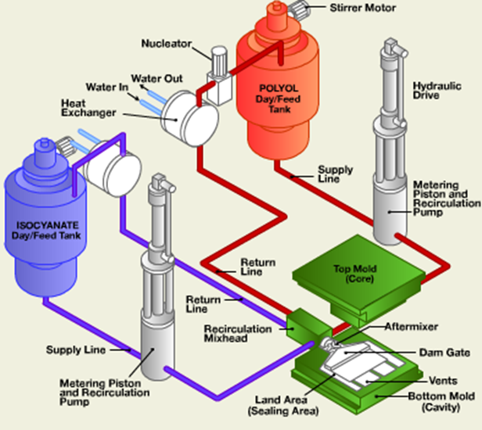
RIM PROCESS
video on RIM process

Slide 7
RIM PROCESS AND EQUIPMENT
day tanks
store unfilled components and filled (reinforced) components
slowly and continuously agitate by mixing impellers to prevent settling of fibers
may have heating jackets for temp control
pressurized at 15 - 60 psi
metering cylinders fill with components from day tanks
components could be moved directly from the pressurized tanks with air pressure, however usually transferred with the assistance of feeder pumps
feeder pumps can provide continuous recirculation (maintain filler in suspension and uniform temp)

Slide 8
MIXING OF COMPONENTS
after metering cylinders filled, they are driven forward by hydraulic pressure to deliver components to mixhead at a known rate (delivery of the two components must be closely synchronized to ensure a uniform reaction and consistent properties in cured part)
during first part of plunger travel, valve to mixing chamber is closed - components are recirculated through head into return lines and back to day tanks
after preliminary recirculation - mixhead valve is opened, components enter the chamber to be mixed
mix chamber is usually small cylinder - components enter from opposite sides of chamber
mixhead is designed to develop turbulence in the mix chamber to intimately mix the two components
turbulence created by stream impingement at high pressure (1,500 - 3,000 psi)
streams should have equal momentum at the time they meet

Slide 9
FILLING THE MOLD
after metering the shot, mixhead valve is closed, components recirculated back into day tanks
metered shot is cleared from mixing chamber by a close fitting ram and flows directly into mold (no solvent flush required)
mold normally filled from bottom so air can easily push out ahead of flow
shot fills mold to about 90% and expansion during chemical reaction of the polyol and isocyanate completes the fill

Slide 10
CURING AND DEMOLDING
components react and gel within 2 - 10 secs from the start of injection
mold remains closed for a period of time to allow sufficient cure so part can be removed and handled without damage (30 - 90 secs)
knockout pins, automatic slides, or pneumatic devices in the mold used to assist with demolding
for small flexible parts may use rubber spatula to pry part loose or insert air nozzle and blow off
for most resin formulations, parts are post-cured in an oven

Slide 11
ADVANTAGES/DISADVANTAGES OF RIM PROCESS
many of the same advantages/disadvantages as RTM process
differences with RTM process
RIM resin builds viscosity rapidly (higher average viscosity during mold filling)
applications must be simple geometries
SRIM preform must be less complex and lower in reinforcement content
parts do not normally flash out of mold parting line sufficiently to require sealing beyond metal land area or a pinch off around perimeter of part (low viscosity of RTM resin requires gasket or o-ring)
highly reactive nature of RIM resin systems leads to cycle times currently faster than achieved with RTM process
mix ratios of RIM resin systems nearly 1:1 in volume
ideally suited to impingement mixing process
self-cleaning mix element
RTM ratios (as high as 100:1 by volume) require mixing in a static mixer and subsequent solvent flush

