Slide 1
SPRAY-UP

Slide 2
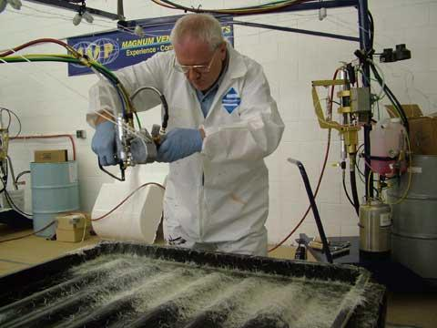
WHAT IS SPRAY-UP?
one or more continuous fiber rovings fed through a chopper
fiber rovings are cut to predetermined lengths
chopped fibers are propelled into resin stream
resin and chopped fibers are deposited simultaneously on mold
rolled by hand with serrated rollers
"automated wet lay-up" (however fibers not continuous)
YouTube video

Slide 3
ADVANTAGES OF SPRAY-UP
rapid lay-up
ability to fabricate large, complex shapes where forming and fitting of mat or fabric would be difficult

Slide 4
REINFORCING FIBER AND RESIN SYSTEM
E-glass roving
polyester resin
base resin (includes crosslinking agent, usually styrene)
catalyst (initiator)
accelerator

Slide 5
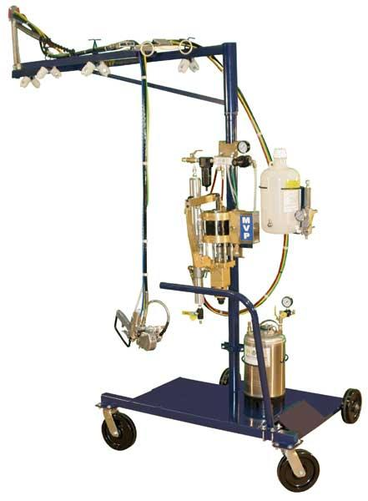
SPRAY-UP SYSTEM COMPONENTS
pumps for resin and/or catalyst
pressure pots for catalysts
pressure pots for flushing solvents
chopper for fiber reinforcement
various air regulators and gauges for control
boom and dolly assembly or chassis
various hoses for transporting materials
gun assembly for dispersing materials
compressed air source

Slide 6
RESIN SYSTEM MIXING METHODS
external mix
resin/catalyst
resin and catalyst/resin and accelerator (two-pot system)
internal mix
resin/catalyst (catalyst injection)
air-atomized - addition of air into the gun to disperse resin mix
airless (flow coaters) - hydraulic pressure to disperse resin mix

Slide 7
CHOPPERS
chops continuous fiber roving in lengths typically 0.5 in. - 2.0 in.
driven by small air motor, speed can be controlled by valves
exhaust usually ducted into the chopper chamber to thrust chopped roving toward resin
chopper comprised of two rollers
one made of rubber or urethane (cott wheel)
one made of aluminum with fitted slots to hold razor blades (cutter wheel)
air motor drives either wheel with the roving passing between the two wheels

Slide 8
WHAT SHOULD BE CONSIDERED IN SELECTING A SPRAY-UP SYSTEM?
resin/fiber output - rate the gun to the anticipated operation (capabilities up to 30 lbs/min glass/resin mixture)
gun weight and balance - continuous operation should not cause undue discomfort to the operator
controls (gun triggers, resin and catalyst flow controls) - conveniently located and easy to use (ideal gun is one which can be operated with one hand)
spray head adjustment - correct, rapid alignment of the resin nozzle's output contacting the chopped roving
gun cleaning and maintenance -
simple gun design with a limited number of parts
can be dismantled with standard tools
packing and gaskets will not be damaged by solvents or other materials used
resin metering devices - if large quantities of resin are to be handled continuously consider the metering control
parts availability - manufacturer stocks replacement parts

Slide 9
FABRICATION PROCESS
gun calibration (collect resin and chopped roving for 15 sec in separate bags)
if gel coat spray thin pass of resin (no chopped roving)
usually start spray passes at bottom of mold using horizontal spray pattern
overlap about one-third to assure uniform layer
follow horizontal layer with vertical layer, if possible (will yield best uniform laminate)
gun head 18 - 24 in from the mold surface
most outputs and operators maintain 0.050 in nominal thickness per pass

Slide 10
ADDITIONAL PROCESSING IS NEEDED AFTER CHOP IS APPLIED TO MOLD
best laminate - one pass, roll out, let gel, continue
rolled by hand with serrated rollers (aluminum or plastic) to remove air, compact the fibers and smooth the surface
start rolling near center and work to edges
where reinforcement bridges female contours work down into contours by pulling fibers from edge to center of female contour
male molds easier to spray-up and roll out, however usually more fiber and resin overspray (waste) on floor
cure will be similar to wet lay-up

