Slide 1
TOOLING

Slide 2
WHAT IS REQUIRED OF THE TOOL?
able to produce a part of acceptable quality
support weight of the part
maintain structural integrity and dimensional stability following multiple heating and cooling cycles
sustain handling loads
able to achieve a specified temperature at a specified rate
accommodate fabrication process

Slide 3
DECISIONS REGARDING THE TOOLING
male (convex) or female (concave)- which face of part should be tool surface
tooling materials
wood
plaster
foam
polyurethane, silicone, latex
salt/sand (single use)
metal
composite
issues driving the selection of tooling material
life (number of cycles)
cost
nonrecurring - machinability (aluminum easier to machine than steel)
recurring - ease of repair
heat transfer capability
heat up and cool down times
ability to control tool temperature
thermal characteristics of tooling materials

Slide 4
“HARD” TOOLING VS “SOFT” TOOLING
hard tooling
many cycles
high cost
soft tooling
few cycles
difficult to maintain tight tolerances
low cost

Slide 5
THERMAL EXPANSION MUST BE ACCOUNTED FOR IN THE DESIGN OF TOOLING
prior to gel, “wet” part and tool expand together
at certain time/temperature part gels
tool and part expand at own rate depending on respective CTEs
cool down at respective CTEs
thermal stresses can be introduced
difficulty extracting tool
dimensioning tool to account for the different CTEs and change in temperature
tolerances on tooling typically ¼ tolerances on part

Slide 6
TOOLING DESIGN EXAMPLE
Design the tooling (material and dimensions) to produce each of the two C-channel designs defined below. The program requires production of 5,000 C-channels of each design. A smaller C-channel is bonded to the inside flanges of the C-channels shown below to form a box beam configuration. The C-channels are fabricated with a carbon/epoxy system. The C-channels are cured in an autoclave at 350°F, 100 psi.
design #1: [±50°]_{s}, CTE (90° direction) = -0.2893 x 10-6 in/in/°F
design #2: [±25°]_{s}, CTE (90° direction) = 9.4869 x 10-6 in/in/°F
C-channel sketch

Slide 7
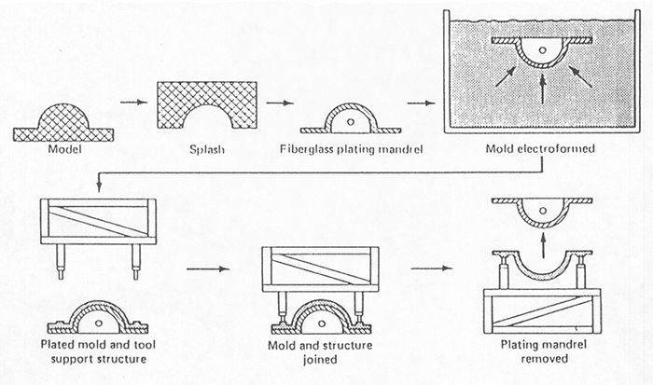
METAL TOOLING
machined
electroforming (typically nickel, 0.125 in thick)
fiberglass plating mandrel placed in nickel solution
thickness build up 0.0005 in - 0.001 in/hr

Slide 8
COMPOSITE TOOLING
good match between tooling CTE and part CTE
lightweight - reduces handling costs
lower cost
limited life in comparison with metal tools

Slide 9
FABRICATION OF COMPOSITE TOOLING
female tool (model (plug) - splash - master - tool)
model - wood, plaster, ...
splash - room temp cure (low cost E-glass)
master (transfer tool) - room temp cure/high service temp resin
tool - high temp cure/service temp resin (temp capability > part cure temp)
male tool (model - master - tool)
lay-up
isotropic (0°/±45°/90°)s
lightweight fabrics against gel coat (will not print through), medium fabrics next, heavy weight fabrics to build up thickness
face sheet - reinforcing ribs - base (egg crate)
substructure should be of similar materials to minimize thermal stresses due to CTE mismatch
minimize effect of substructure to create thermal gradients through face sheet

Slide 10
METAL-COATED COMPOSITE TOOLING
combine advantages of metal and composite
metal
long life
excellent mold surface finish
faster heat up times
ease of repair
composite
lightweight
lower cost
ease in producing large molds
methods of fabricating
plate composite tool with metal by electrolytic or chemical plating
plate or thermal spray metal on master, then fabricate composite tool over metal surface

Slide 11
OTHER TYPES OF TOOLING
segmented tools (mandrels) to prevent “trapped” tooling
elastomeric (silicone rubber) tooling
trapped rubber molding
used in areas with special pressure needs (pressure intensifiers)
internal bladder/closed mold
integral tooling
caul plates
distribute applied pressure evenly over part
maintain heat transfer similar to tool side
ply locating templates

Slide 12
EXTRACTING THE TOOLING
tool should be designed to facilitate extraction
taper
take advantage of CTE mismatch
jacking points
grapple points
blow holes

Slide 13
PROTOTYPE TOOLING
composite tool
two-part mold (mold #1, mold #2, part)
aircraft cowling (using foam plug)
polyurethane, silicone tool (Freeman Mfg videos)
latex tool

