Slide 1
Cash Flows

Slide 2
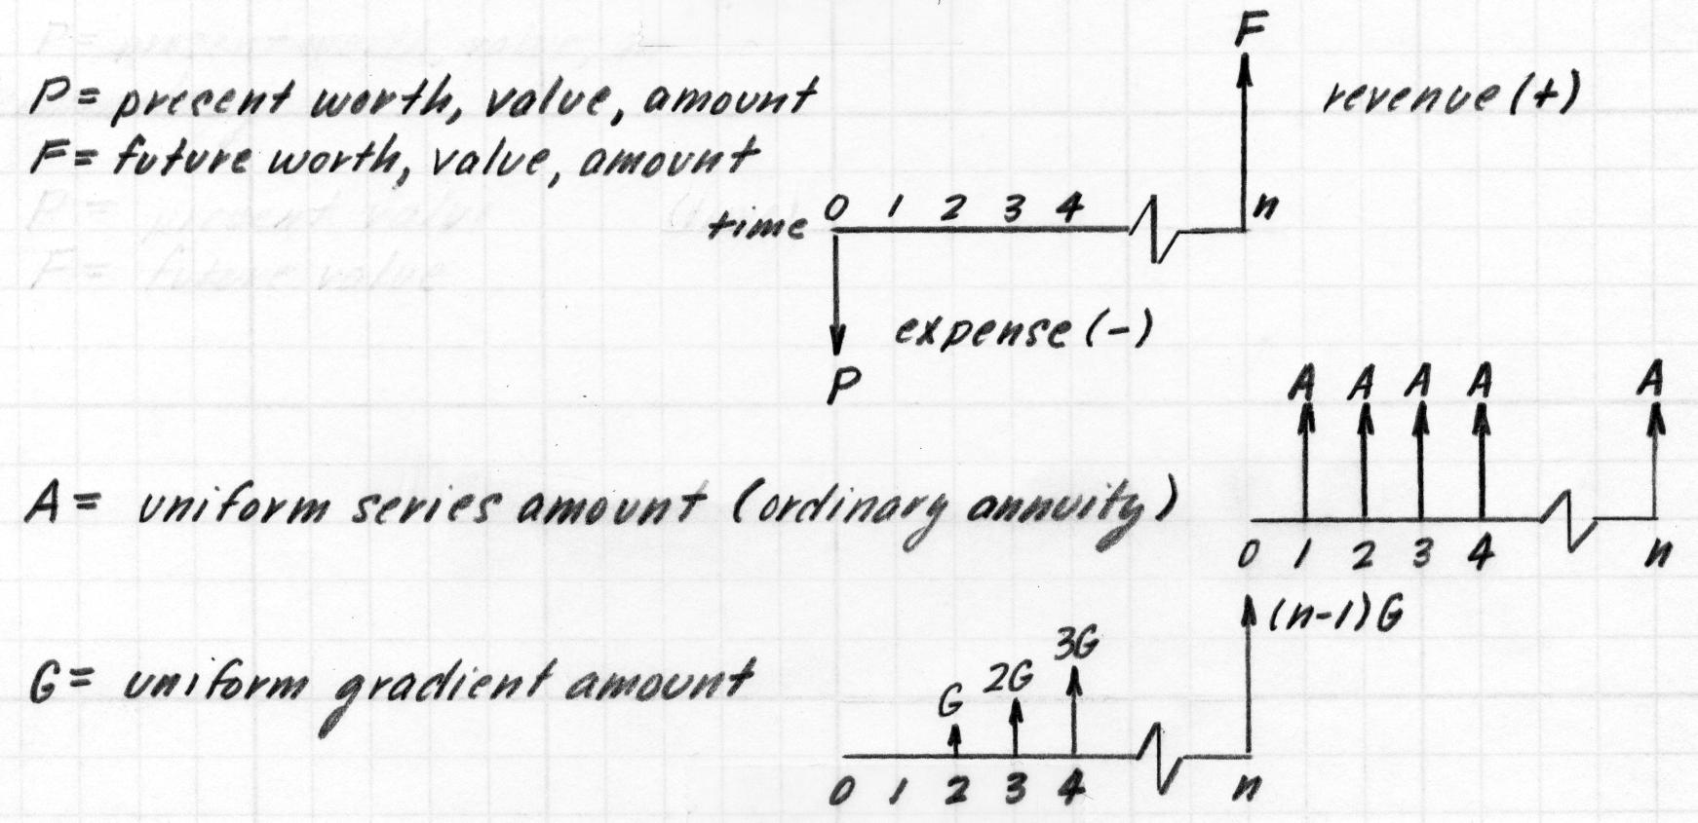
Terminology and the Cash Flow Diagram
Cash flow diagram (is it revenue or expense?) is dependent on the point of view

Slide 3
Derivation
Future worth, F, given
interest rate per interest period, i
number of compounding periods, n
F = P(1+i)^{n}
P = F(1+i) ^{-n}
today | end of period 1 | end of period 2 | end of period 3 | end of period n

Slide 4
Examples
Suppose you borrow $8,000 now, promising to repay the loan principal plus accumulated interest in four years at i = 10%. How much would you repay at the end of four years?
An investor (owner) has an option to purchase a tract of land that will be worth $10,000 in six years. If the value of the land increases at 8% each year, how much should the investor be willing to pay now for the property?

Slide 5
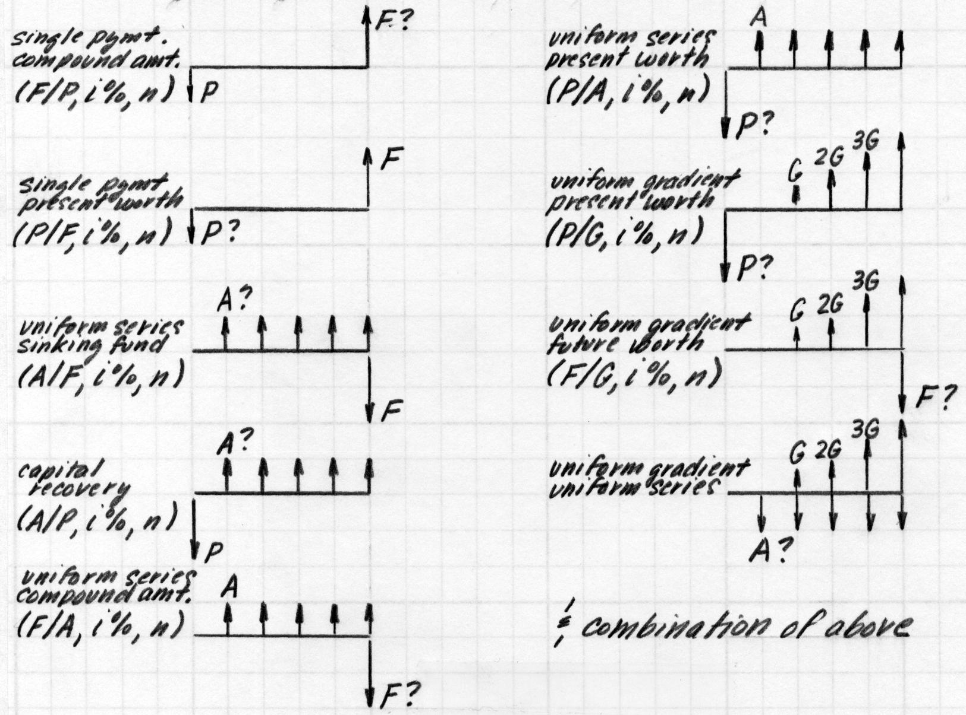
Different Types of Cash Flows
Reading of symbol, (F/P, i, n): future worth (F) given the present worth (P) at an interest rate per period of i% over n periods

Slide 6
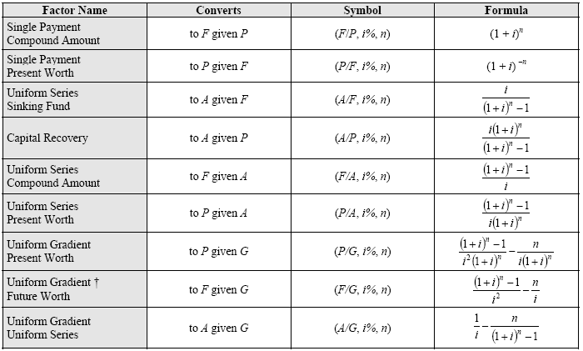
Formulas for the Different Types of Cash Flows
From the FE Supplied-Reference Handbook

Slide 7
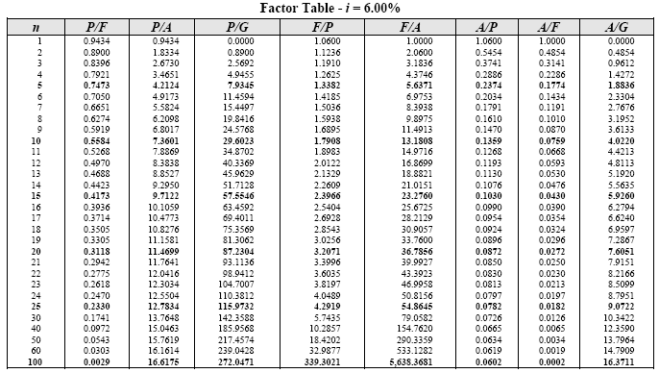
Factor Tables for the Different Types of Cash Flows
From the FE Supplied-Reference Handbook

Slide 8
Examples
Suppose you make 15 equal annual deposits of $1,000 each into bank account paying 5% interest per year. The first deposit will be made one year from today. How much money can be withdrawn from this bank account immediately after the 15th deposit?
If you are 20 years of age and save $1.00 each day for the rest of your life, can you become a millionaire? (assume you deposit your $365 at the end of each year, save to age 80 (60 years), and that the annual interest rate is 10%)
If a certain machine undergoes a major overhaul now, its output can be increased by 20% - which translate into additional cash flow of $20,000 at the end of each year for five years. If i = 15% per year, how much can we afford to invest to overhaul this machine?

Slide 9
Examples
Suppose your rich uncle has $1,000,000 that he wishes to distribute to his heirs at the rate of $100,000 per year. If the $1,000,000 is deposited in a bank account that earns 6% interest per year, how many years will it take to completely deplete the account? How long will it take if the account earns 8% interest per year instead of 6%?
An enterprising student is planning to have personal savings totaling $1,000,000 when she retires at age 65. She is now 20 years old. If the annual interest rate will average 7% over the next 45 years on her savings account, what equal end-of-year amount must she save to accomplish her goal?

Slide 10
Example
Calculate the present worth of the following cash flows assuming an i of 15% (make use of the gradient conversion factors)
End of Year | Cash Flows ($)
1 | -5000
2 | -6000
3 | -7000
4 | -8000

Slide 11
Interest Rates
Simple interest - only original principal accrues interest
Compound interest
interest rate per period, i
annual effective interest rate, i_{e}: rate that would yield the same accrued interest at the end of the year if the amount was compounded annually
nominal interest rate (per annum), r: compounding more than once per year
Unless specifically qualified in a problem, the interest rate given is an annual rate.
If the compounding period is annual or is not specified, the interest rate is the annual effective interest rate, i_{e}
If compounding is not annual, the rate given is the nominal interest rate, r

Slide 12
Interest Compounded Semi-annually
Receive interest twice per year
Interest rate for 6 months is half the annual nominal interest rate, r
F = P (1+r/m)^{n} = P (1+r/m)^{my}
r = annual nominal interest rate
m = number of compounding periods per year
y = number of years of accumulation
today | 6 months | 1 year | 18 months | end of period n

Slide 13
Annual Effective Interest Rate Given Non-annual Compounding
Given one year (y = 1)
P (1+r/m)^{m(1)} = P (1+i_{e})⁽¹⁾
(1+r/m)^{m} = (1+i_{e})
i_{e} = (1+r/m)^{m} - 1

Slide 14
Examples
A bank advertises that it pays interest at the rate of 10% per year, compounded quarterly. What annual effective interest rate is the bank paying?
A bank pays interest at the rate of 6% per year, compounded monthly. If a person deposits $2,500 in a savings account at the bank, how much money will accumulate by the end of 2 years?
A person plans to buy a $150,000 house. They will make a down payment of $30,000 and take out a 30-year mortgage for the remaining amount, at 10% per year, compounded monthly. How much must they repay each month?
What is the present value of a stream of monthly payments of $500 each over 10 years, if the interest rate is 10% per annum, compounded monthly?
Suppose a person deposits $100 a month during the first year, $110 a month during the second year, $120 a month during the third year, etc. How much will have accumulated at the end of 5 years if the interest rate is 6% per year, compounded monthly?

Slide 15
Timing of Interest Periods Are Different Than Timing of Payment Periods
Interest periods smaller than payment periods
interest may be compounded several times between payments
two solution methods
(1) determine the effective interest rate for the given interest period, and then treat each payment separately
(2) calculate an effective interest rate for the given payment period, and then proceed as though the interest periods and the payment periods coincide
Interest periods larger than payment periods
some of the payments may not have been deposited for an entire interest period and do not earn any interest during that interest period
consider all deposits that were made during the interest period to have been made at the end of the interest period
consider all withdrawals that were made during the interest period to have been made at the beginning of the interest period
then proceed as though the interest periods and payment periods coincide

Slide 16
Examples
A person deposits $1,000 in a savings account at the end of each year. If the bank pays interest at the rate of 6% per year, compounded quarterly, how much money will have accumulated in the account after 5 years?
How much money must be deposited in a savings account at the end of each month to accumulate $10,000 at the end of 5 years, if the bank pays interest at the rate of 6% per year compounded (a) monthly? (b) semiannually? (c) quarterly? (d) daily?

