Slide 1
Depreciation

Slide 2
What is depreciation?
Depreciation is an accounting concept that establishes an annual deduction against before-tax income such that the effect of time and use on an asset's value can be reflected in a firm's financial statements

Slide 3
What constitutes a depreciable property?
It must be used in business or held to produce income
It must have a determinable useful life and the life must be longer than one year
It must be something that wears out, decays, gets used up, becomes obsolete, or loses value from natural causes
It is not inventory, stock in trade, or investment property

Slide 4
Classifications of depreciable property
Tangible property - can be seen and touched
Personal property - machinery, vehicles, equipment, furniture, ...
Real property - land and generally anything that is erected on, growing on, or attached to land (however land is not depreciable, it does not have a determinable life)
Intangible property - personal property such as a copyright, patent, or franchise

Slide 5
Depreciation timeframe
Company can begin to depreciate property it owns when the property is placed in service for use in the business and for the production of income
Property is considered to be placed in service when it is ready and available for a specific use, even if it is not actually used yet
Depreciation stops when the cost of placing an asset in service has been recovered

Slide 6
Depreciation methods permitted by the Internal Revenue Service
Before 1981 - the depreciation methods used were primarily Straight-Line (SL), Declining Balance (DB), and Sum of the Years Digits (SYD)
After 1980 and before 1987 - for federal income taxes, tangible property placed in service during this period must be depreciated by using the Accelerated Cost Recovery System (ACRS)
After 1986 - the Modified Accelerated Cost Recovery System (MACRS) is required for the depreciation of tangible property placed in service after 1986
There is also a method where the decrease in value is not a function of time (number of years), but rather it is a function of use - Units-of-Production method

Slide 7
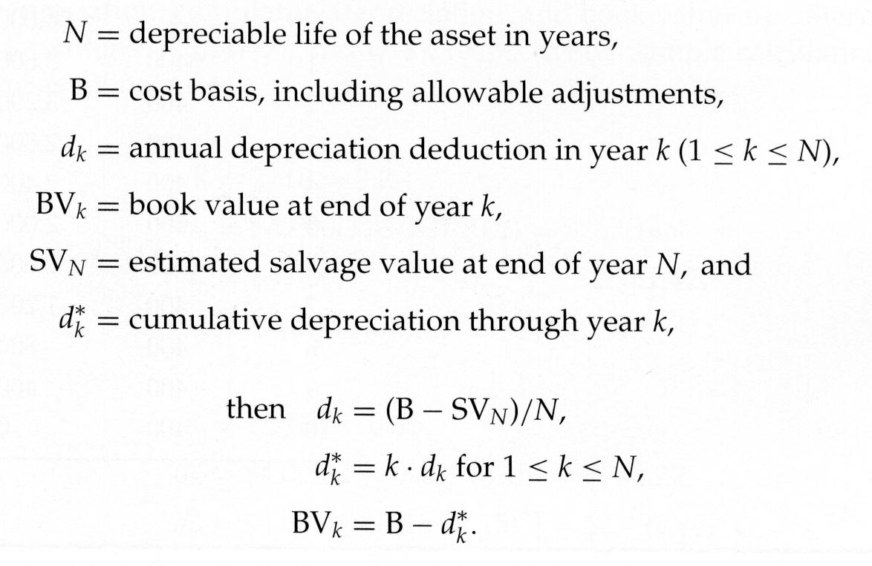
SL depreciation method
Assumes that a constant amount is depreciated each year over the depreciable (useful) life of the asset

Slide 8
SL depreciation method example

Slide 9
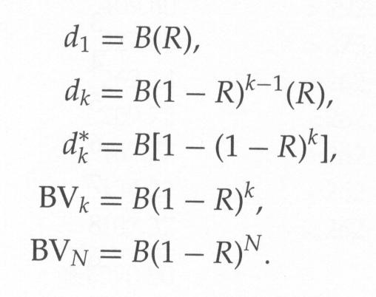
DB depreciation method
Annual cost of depreciation is a fixed percentage of the BV at the beginning of the year
The ratio of the depreciation in any one year to the BV at the beginning of the year is constant throughout the life of the asset and is designated by R
200% DB is being used, then R=2/N, where N = the depreciable (useful) life of an asset
150% DB is being used, then R=1.5/N
SV is not in any of the equations below, however BV can’t fall below SV and this will limit d_{k}

Slide 10
DB depreciation method example
Rework previous example with the DB method when
R = 2/N (200% DB method)
R = 1.5/N (150% DB method)

Slide 11
DB method with switchover to SL method
DB method never reaches a book value of zero
It is permissible to switch from the DB method to the SL method so that an asset's BV_{N} will be zero (or some other determined amount, such as SV_{N})
Rework previous example with switchover to SL method

Slide 12
MACRS
MACRS applies to most tangible depreciable property placed in service after December 31, 1986
Examples of assets not depreciated under MACRS include property that one elects to depreciate under a method that is not based on a term of years (units-of-production method) and intangible property
The salvage value of an asset at the end of its useful life is defined to be zero
Useful life estimates are not used directly in calculating depreciation amounts - asset classes have been established and assigned a class life
Depreciation rates (from the tables) are applied to the unadjusted basis of one’s property in each year of the recovery period

Slide 13
MACRS consists of two systems for computing depreciation deductions
General Depreciation System (GDS)
Most tangible personal property is assigned to one of six personal property classes (3-, 5-, 7-, 10-, 15-, and 20-year property)
Real property is assigned to one of two real property classes, nonresidential real property and residential real property
Alternative Depreciation System (ADS)
Provides a longer recovery period and uses only the SL method of depreciation
Property placed in any tax-exempt use and property used predominantly outside the US are examples of assets that are required to be depreciated under ADS
Any property that qualifies under GDS can be depreciated under ADS, if elected

Slide 14
MACRS class lives and recovery periods
IRS Publication 946 (2022), How To Depreciate Property
Table A-1
Table B-1 is many pages - in general, asset classes in the high 20's through low 30's are related to the composites/plastics industry

Slide 15
MACRS depreciation amounts
For GDS 3-, 5-, 7-, and 10-year personal property classes: the 200% DB method, which switches to the SL method when that method provides a greater deduction
For GDS 15- and 20-year personal property classes: the 150% DB method, which switches to SL method when that method provides a greater deduction
For GDS nonresidential real and residential rental property classes: the SL method over the fixed GDS recovery periods
For ADS personal and real property classes: the SL method over the fixed ADS recovery periods

Slide 16
Half-year time convention
An asset placed into service anytime during the year can be treated as if use began in the middle of the year and one-half year of depreciation is allowed
When the asset is disposed of the half-year convention again applies
If the asset is disposed of before the full recovery period is used, then only half of the normal depreciation can be taken for that year
An alternate procedure is to record the quarter in which the asset is placed into service and a prorated amount of depreciation is allowed using the mid-quarter date

Slide 17
Comparison of Depreciation Methods Example
The Bus Company has decided to purchase a new bus for $85,000 with a trade-in of their old bus. The old bus has a BV of $10,000 at the time of the trade-in. The new bus will be kept for 10 years before being sold. Its estimated salvage value at that time is expected to be $5,000.
SL method
(200%) DB method
(200%) DB method with switchover to SL
MACRS (GDS) with half-year convention
bus is sold in year five
bus is sold in year six
Solution

Slide 18
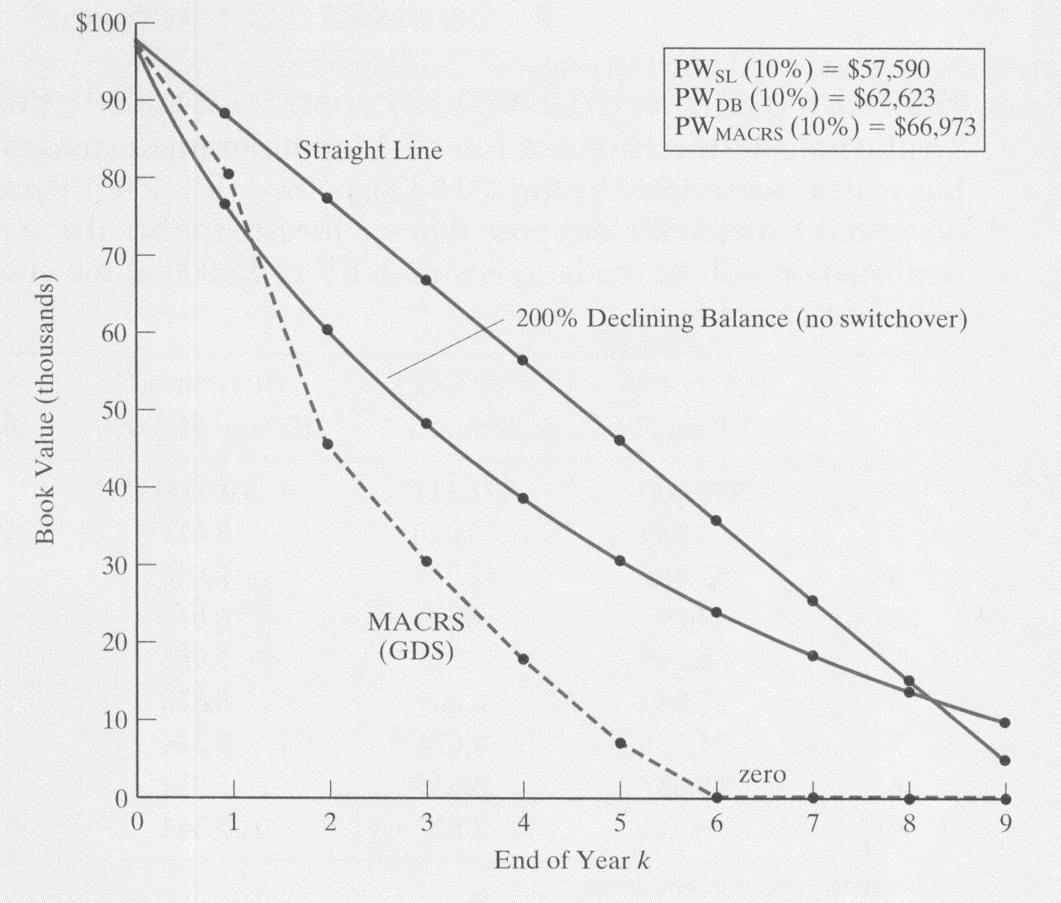
Example (continued)

