Slide 1
Corporate Income Taxes

Slide 2
Different Types of Corporate Taxes
Income taxes
assessed on gross revenues minus allowable deductions
levied by federal, most states, and sometimes municipal governments
Property taxes
Sales taxes (adds to the cost of items purchased)
Excise taxes
federal taxes assessed as a function of the sale of certain goods and services (https://www.taxpolicycenter.org/briefing-book/what-are-major-federal-excise-taxes-and-how-much-money-do-they-raise)
may be charged to manufacturer or original provider of the goods or services

Slide 3
Corporate Taxable Income
Taxable income = gross income - all expenses except capital investments - depreciation deductions
Federal Tax rate schedule (IRS Publication 542)
State income taxes
in most cases much less than federal taxes and is often in the range of 6% to 12% of taxable income (MN is 9.8%)
state income taxes are deductible from taxable income for federal tax purposes, but federal income taxes are not deductible from taxable income for state tax purposes
General expression for the effective income tax rate
t = state rate + federal rate*(1 - state rate)
using a federal rate = 21% and a state rate = 9%, t ≈ 30% (prior to changes in 2017, the federal rate = 35%, t ≈ 40%)

Slide 4
Income Tax Example

Slide 5
Tax Consequences of a Gain (Loss) on the Disposal of an Asset
When a depreciable asset is sold, the market value rarely equals the book value, a gain (loss) results
Gain (loss) on disposal = MV - BV
When the sale results in a gain, it is often referred to as depreciation recapture
The tax rate for the gain (loss) on disposal of depreciable personal property is typically the same as for ordinary income or loss (the effective income tax rate, t)

Slide 6
Project After Tax Cash Flows

Slide 7
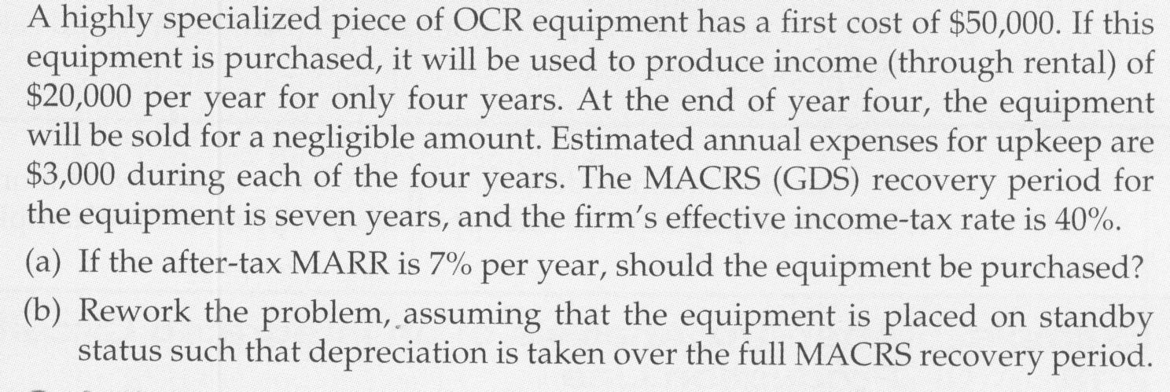
ATCF In Tabular Format
Solution

