Slide 1
Inflation

Slide 2
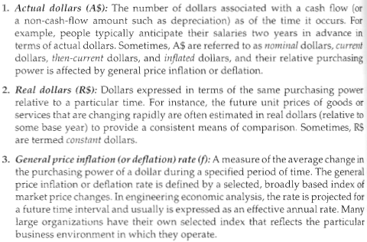
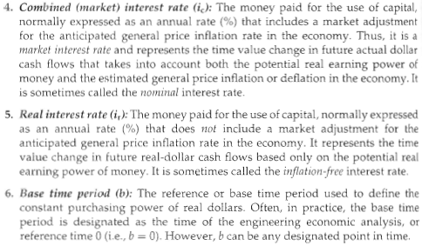
Terminology
www.bls.gov/cpi

Slide 3
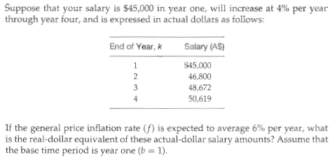
Example

Slide 4
Example
If a company borrowed $100,000 today to be repaid at the end of three years at a combined (market) interest rate of 11%, what is the actual-dollar amount owed at the end of the three years, the real interest rate, and the real-dollar amount equivalent in purchasing power to the actual-dollar amount at the end of the third year? The base or reference period is now (b=0) and the general price inflation rate (f ) is 5% per year.

Slide 5
Equations
Thinking in terms of the future worth one year into the future
1+i_{c} = (1+f)(1+i_{r})
1+i_{c} = 1+ i_{r}+f+(f)(i_{r})
i_{c} = i_{r}+f+(f)(i_{r})
i_{c} = i_{r}(1+f)+f
i_{r}(1+f) = i_{c}-f
i_{r} = (i_{c}-f)/(1+f)

Slide 6
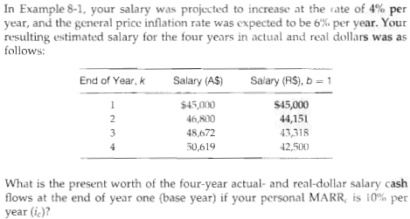
Example

